Slide 1
THE DYNAMICS OF THE CAPITALIST BUSINESS CYCLE
SUBJECT TO CHANGE AT ANY MOMENT!

Slide 2
“IF SOMETHING CAN’T CONTINUE, IT HAS TO STOP!”
HERBERT STEIN

Slide 3
MAIN POINTS
How low can it go? See data from Great Depression – what made the Great Depression Great?
A theory – Minsky: Capitalist Economies are characterized by credit money credit modes of finance (good place to introduce “real bills doctrine” lending for goods in process – only short term lending – from agriculture borrow in spring repay in fall – goods in process) this coupled with the capitalist need to maintain profit rates (animal spirits) create business cycles.
What is happening and what will happen – how do we know?

Slide 4
ON THE RECORD!
It’s always a bit comforting to know that what you said once sometime before was actually not totally off the wall. On November 4, 2005 I was asked to speak on a topic called “Can IT Happen Again” at that time I said:
“The 9/11 Commission recently concluded that part of the problem was a ‘failure of imagination.’ U.S. authorities simply failed to envision that terrorists would turn airliners into missiles. That such a failure took place is now clear to everyone….
Foreign Policy November/December 2004.

Slide 5
Deficits and Debt:
Trade deficit – $500 billion about 3 to 4 percent of GDP. Trade surplus 1981.
Federal debt – $12,316,678,228,131 about 85% of GDP and today it stands perhaps higher in percentage terms – no-one knows, but we are pretty certain it’s larger! Per person that is more than $40,000 per person.

Slide 6
OTHER ISSUES:
Global economic and political problems – e.g. What Happens when the when they blow up the Strait of Hormuz or the Koreans drop a missile on Hawaii?
Medicare – Naïve prediction is that by 2050 or so Medicare alone will make up 14 percent of GDP – means that today with Federal Government taking about 19 percent.
Others too numerous to mention…..

Slide 7
IF SOMETHING CAN’T CONTNUE…
Year Employment Unemployment rate Employment Growth
1950 59
1960 66 5.5 12%
1970 79 4.9 20%
1980 99 7.1 20%
1990 119 5.6 20%
2000 137 4.0 15%
2004 139 5.5 1.5%
2010 143 10.0 2.9%

Slide 8
AND THERE’S MORE!
Productivity increasing at historic rates.
Country melt downs – Greece – Moral Hazard.
Corporate profits after taxes at an all time high.
But profits = investment + government deficit.
Various bubbles e.g. housing, technology, hedge fund, other surprises, inflation or deflation.

Slide 9
The Long Term Problem is the Budget
The Congressional Budget Projects RED Ink and MORE RED INK for the foreseeable future!
Who will lend to us and at what rate?

Slide 10
Notes:
The Federal and some state deficits have expanded to record breaking proportions!

Slide 13
Weaknesses in the economy and financial markets—and the government’s response to them—have contributed to near-term increases in federal deficits, which reached a record level in fiscal year 2009. While a lot of attention has been given to the recent fiscal deterioration, the federal government faces even larger fiscal challenges that will persist long after the return of financial stability and economic growth. GAO’s simulations continue to show escalating levels of debt that illustrate that the long-term fiscal outlook remains unsustainable. In little over 10 years, debt held by the public as a percent of GDP under GAO’s Alternative simulation is projected to exceed the historical high reached in the aftermath of World War II and grow at a steady rate thereafter. According to CBO.

Slide 22
What Made the Great Depression Great?
The American Depression was unique in many ways. While many countries experienced a depression at roughly the same time as the United States, the onset of decline and the subsequent rebound were much more extreme in the United States than elsewhere. The overall depth of the Great Depression was also larger in the United States than in any country other than Poland. Finally, the American Depression was initiated by a fall in consumption and ended by a rise in investment to a degree that was quite different from the experience of many other industrial countries. The picture that I have painted of the American Great Depression is one that stresses the importance of national, rather than international, aggregate demand shocks; the experience of the United States during the 1930s differed in important ways from that of other countries because the American experience had many uniquely American roots. The United States slipped into recession in mid-1929 because of tight domestic monetary policy aimed at stemming speculation on the U.S. stock market. Also Fed still operated on the theory of the “real bills doctrine” – short term loans on goods in process.

Slide 23
What Made the Great Depression Great? (Cont.)
The Great Depression started in earnest when the stock market crash in the United States caused consumers and firms to become nervous and therefore to stop buying irreversible durable goods. The American Depression worsened when banking panics swept undiversified and overextended rural banks and the Federal Reserve failed to intervene. Finally, the American Depression ended when the Roosevelt administration chose to increase the money supply tremendously after 1933. Most of these shocks contain an international element, in one way or another. The tight monetary policy of 1928 was partly aimed at stopping a gold outflow. The Federal Reserve was less able to respond to financial panics in 1931 because expansionary monetary policy would have led to a serious loss of gold. Increasing the money supply after 1933 was very simple because capital flight from Europe brought billions of dollars worth of gold to the United States. Although these international complications were present, they were not decisive. At each stage of the Great Depression, it was ultimately American shocks and American policy decisions that determined the path of American output and employment. Christina Romer

Slide 24
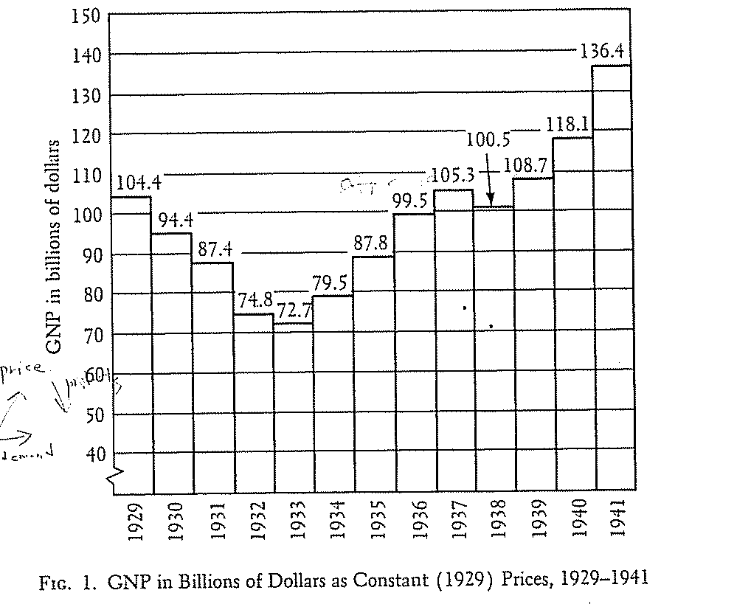
GNP in Billions of 1929 $

Slide 25
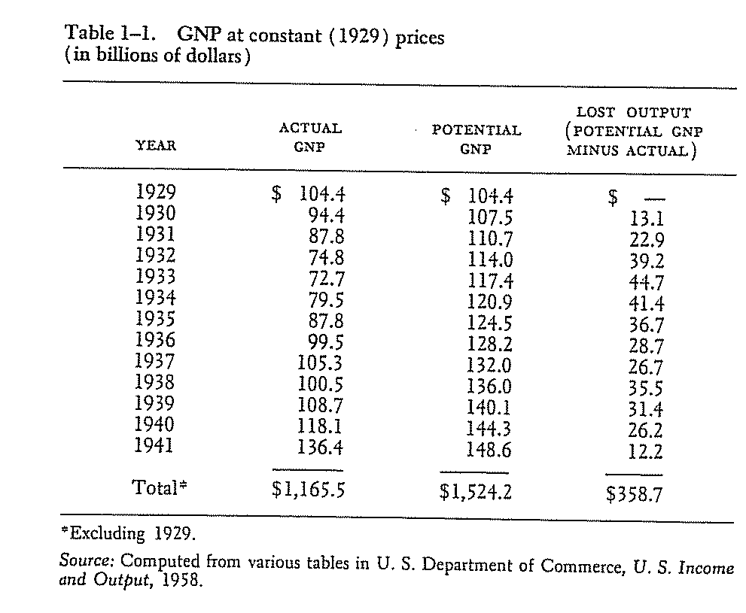
Potential GNP in Billions of 1929 $

Slide 26
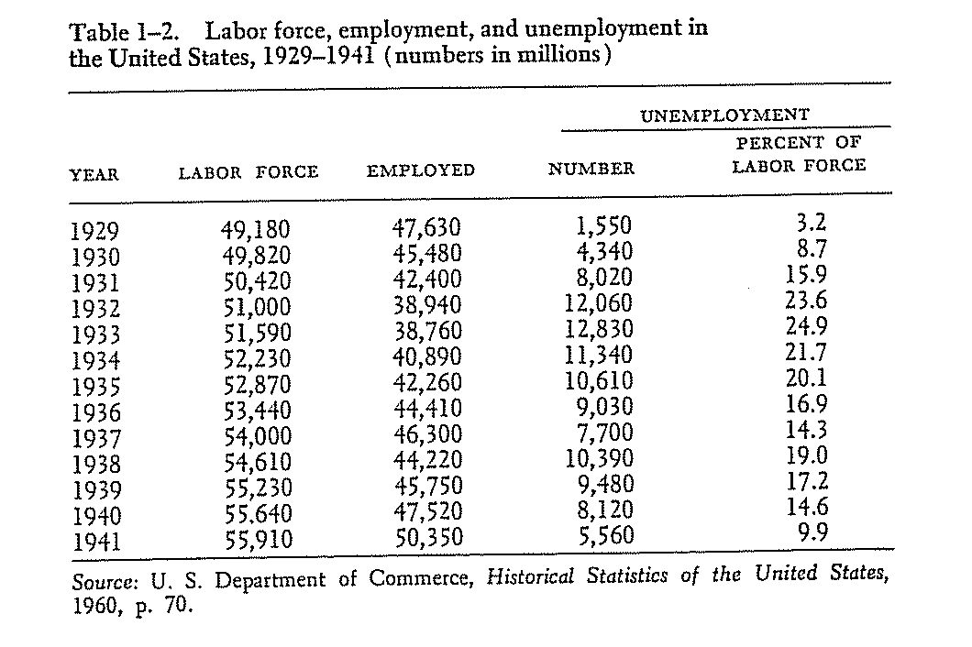
Unemployment

Slide 27
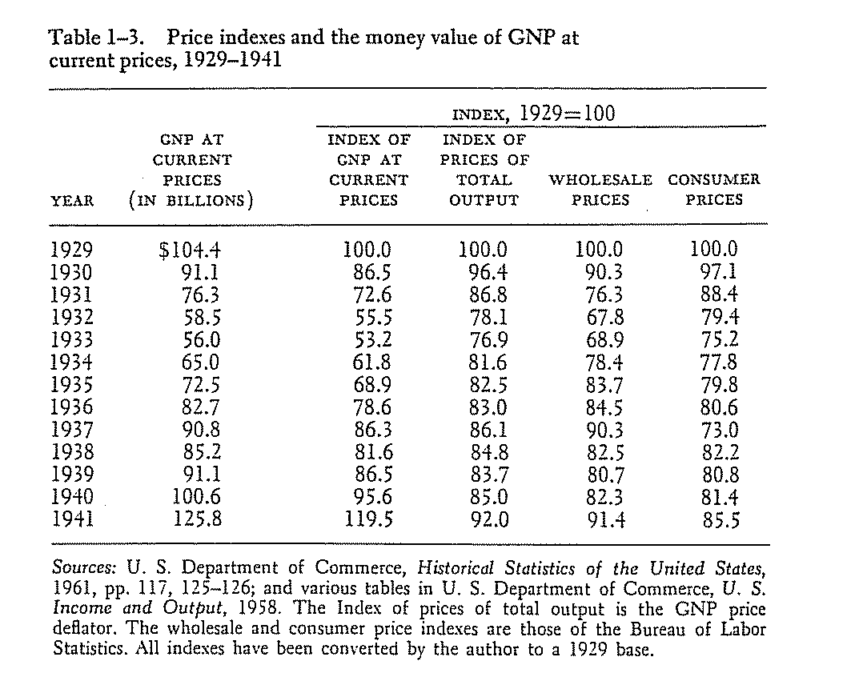
Prices and Money Values of GNP

Slide 28
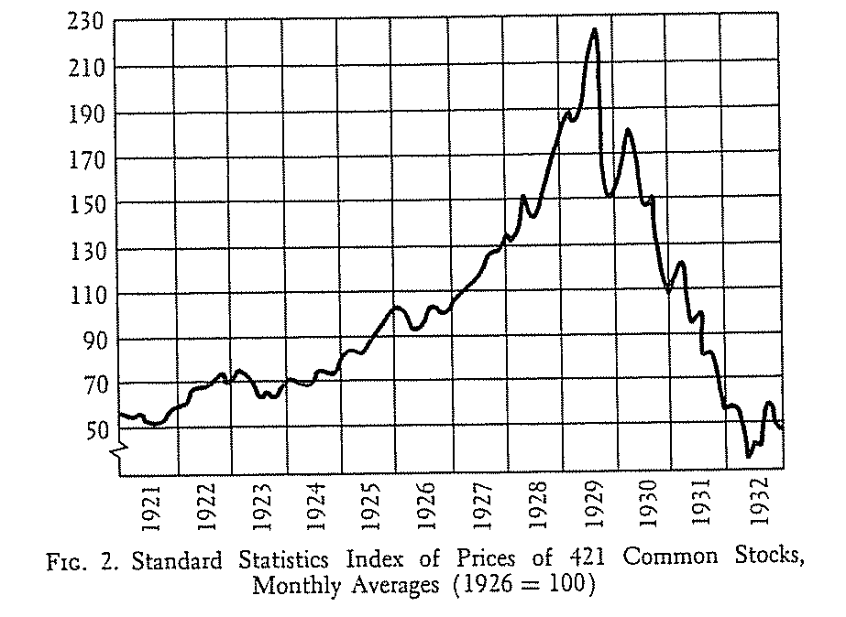
Stock Market

Slide 29
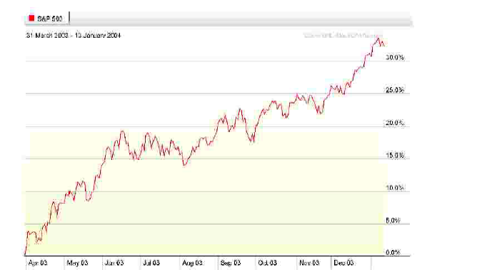
Going Up

Slide 30
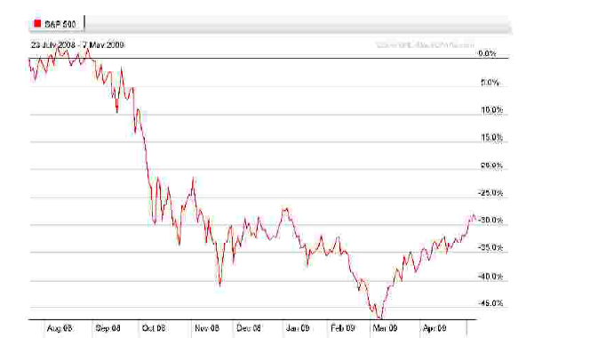
Going Down

Slide 31
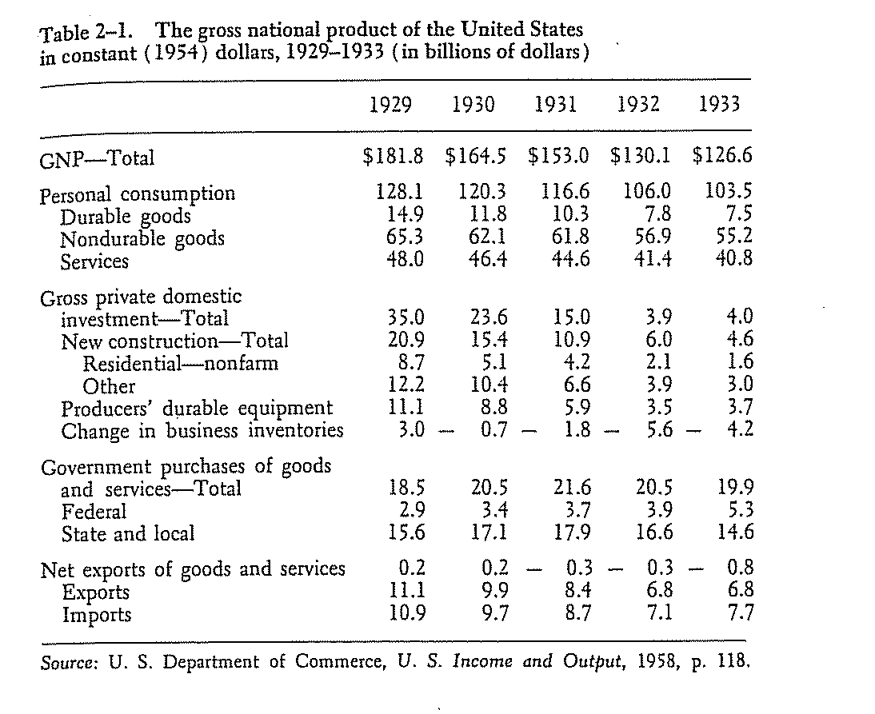
Disaggregated GNP

Slide 32
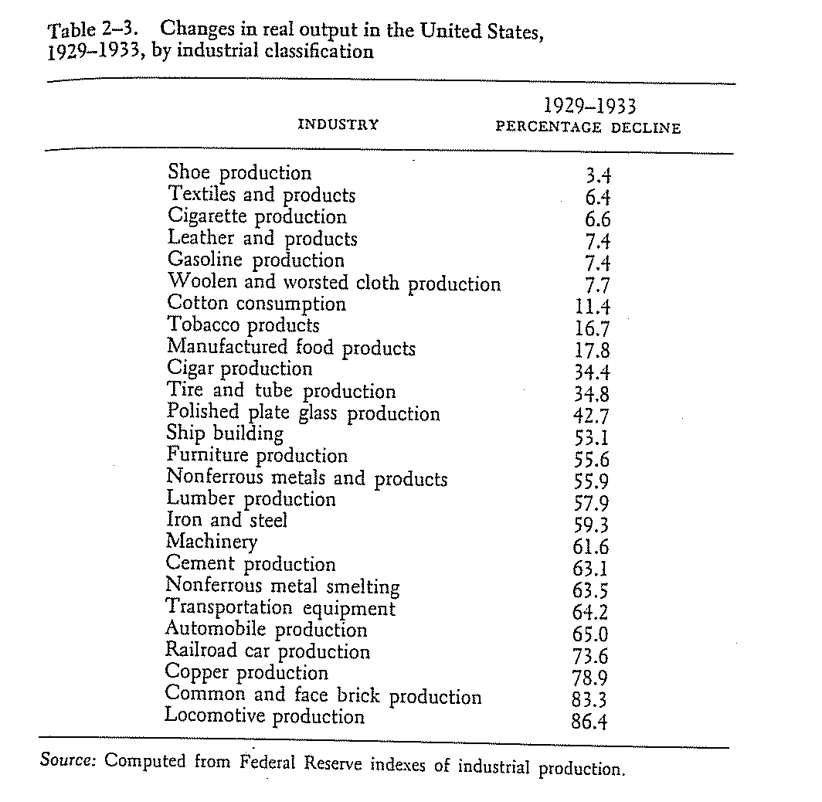
Industrial Declines

Slide 33
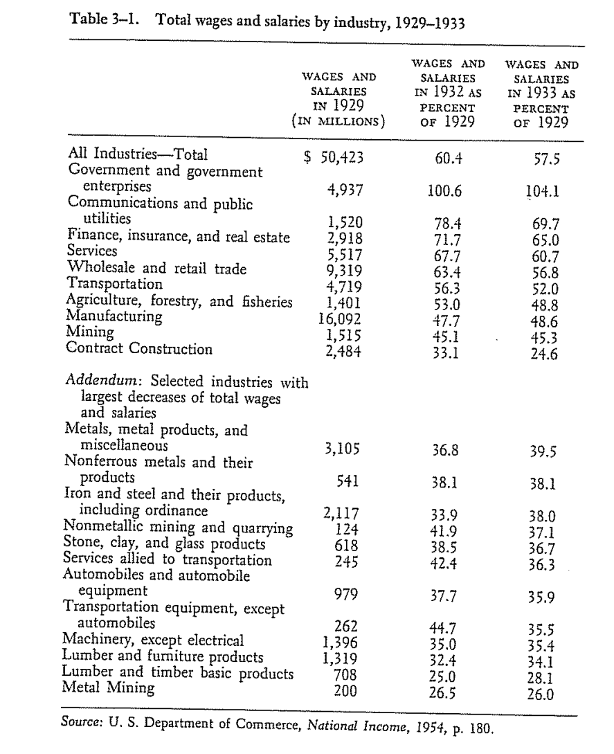
Wages and Salaries

Slide 34
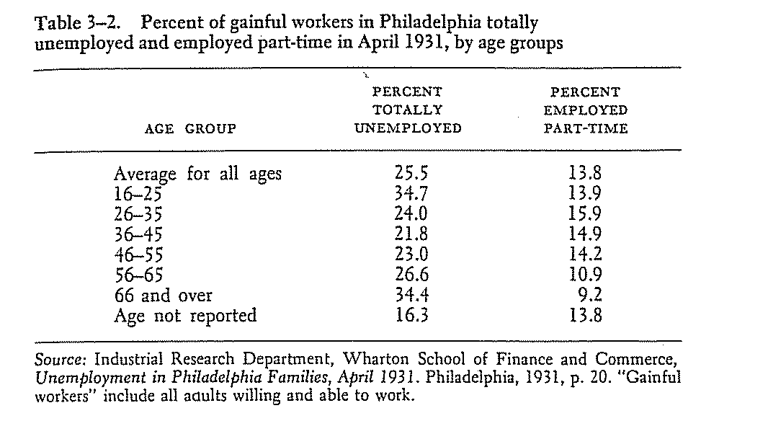
The Unemployed

Slide 35
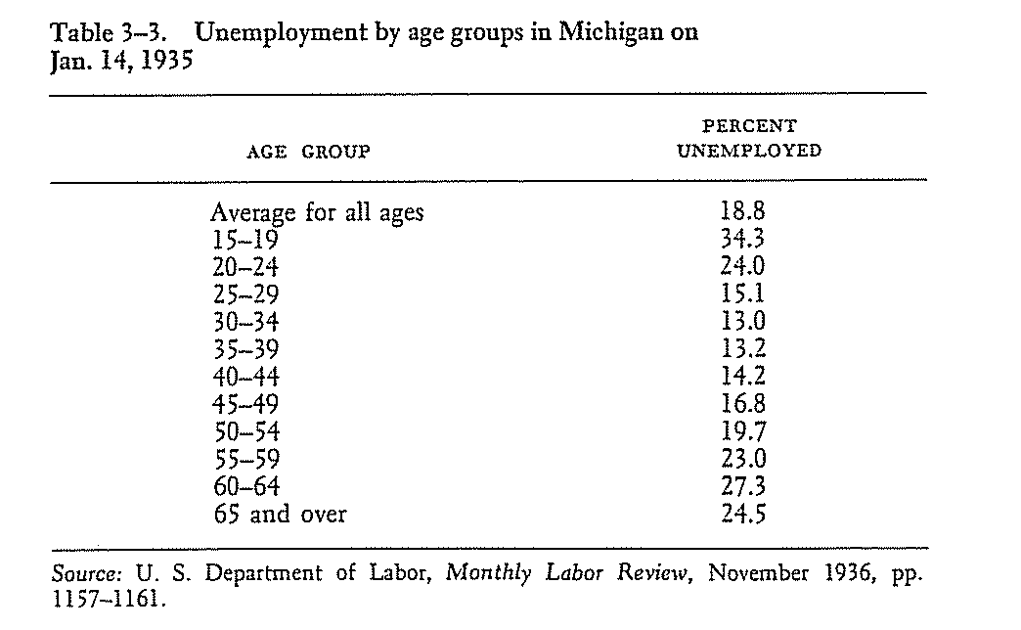
The Unemployed (2)

Slide 36
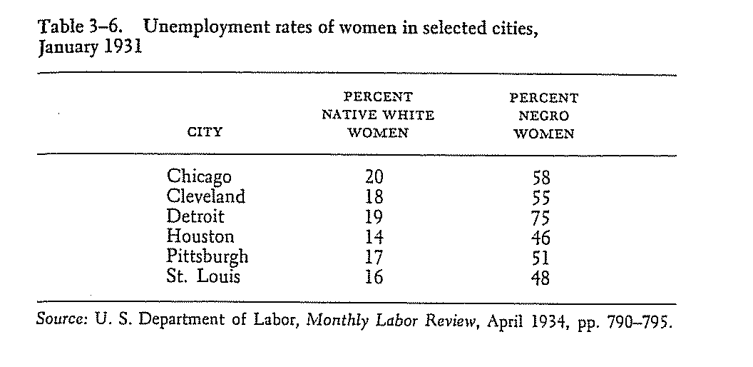
The Unemployed (3)

Slide 37
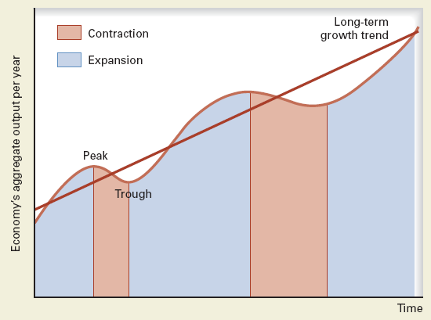
The Business Cycle

Slide 38
The Simplest Capitalist Economy
The Minsky Model – no greed required – no irrationality:
Money to credit to money to credit, etc.
Assume a rate of return (target)
Early in cycle rate of return available for low risk – over simplification – Minsky called this Hedge Financing where both interest and principal could be paid from current cash flow.

Slide 39
The Simplest Capitalist Economy (Cont)
Things become more difficult because such investments (with that given rate of return) become rarer still toward the end of the cycle.
Here Minsky called finance Speculative.
In Speculative finance only interest can be paid with the cash flow from the current investment.

Slide 40
The Simplest Capitalist Economy (Cont)
Things become EVEN more difficult because such investments (with that given rate of return) become rarer still toward the end of the cycle.
Here Minsky called finance Ponzi.
In Ponzi finance only additional credit can be used to pay interest on current credit.

Slide 41
OBVIOUSLY THIS IS THE RECIPE FOR A FALL
At some point agent “X” cannot (or does not) make his/her payments to agent “Y”. This lack of cash flow forces angent “Z” into bankruptcy which interrupts the cash flows to Z’s creditors. Assuming there is a substantial portion of Ponzi finance in the system the economy will enter a phase of debt deflation.

Slide 42
Circular-Flow Model
Households supply resources in the resource market and demand goods and services in the product market
Firms supply goods and services in the product market and demand resources in the resource market
Money flows in resource markets determine wages, interest, rents and profits which flow as income to households
Product markets determine the prices for goods and services which flow as revenue to firms
Leakage is savings –
Injection is Investment

Slide 43
WHERE WE ARE NOW UNEMPLOYMENT
Year | Jan | Feb | Mar | Apr | May | Jun | Jul | Aug | Sep | Oct | Nov | Dec | Annual
1999 | 4.3 | 4.4 | 4.2 | 4.3 | 4.2 | 4.3 | 4.3 | 4.2 | 4.2 | 4.1 | 4.1 | 4.0
2000 | 4.0 | 4.1 | 4.0 | 3.8 | 4.0 | 4.0 | 4.0 | 4.1 | 3.9 | 3.9 | 3.9 | 3.9
2001 | 4.2 | 4.2 | 4.3 | 4.4 | 4.3 | 4.5 | 4.6 | 4.9 | 5.0 | 5.3 | 5.5 | 5.7
2002 | 5.7 | 5.7 | 5.7 | 5.9 | 5.8 | 5.8 | 5.8 | 5.7 | 5.7 | 5.7 | 5.9 | 6.0
2003 | 5.8 | 5.9 | 5.9 | 6.0 | 6.1 | 6.3 | 6.2 | 6.1 | 6.1 | 6.0 | 5.8 | 5.7
2004 | 5.7 | 5.6 | 5.8 | 5.6 | 5.6 | 5.6 | 5.5 | 5.4 | 5.4 | 5.5 | 5.4 | 5.4
2005 | 5.3 | 5.4 | 5.2 | 5.2 | 5.1 | 5.0 | 5.0 | 4.9 | 5.0 | 5.0 | 5.0 | 4.9
2006 | 4.7 | 4.8 | 4.7 | 4.7 | 4.6 | 4.6 | 4.7 | 4.7 | 4.5 | 4.4 | 4.5 | 4.4
2007 | 4.6 | 4.5 | 4.4 | 4.5 | 4.4 | 4.6 | 4.6 | 4.6 | 4.7 | 4.7 | 4.7 | 5.0
2008 | 5.0 | 4.8 | 5.1 | 5.0 | 5.4 | 5.5 | 5.8 | 6.1 | 6.2 | 6.6 | 6.9 | 7.4
2009 | 7.7 | 8.2 | 8.6 | 8.9 | 9.4 | 9.5 | 9.4 | 9.7 | 9.8 | 10.1 | 10.0 | 10.0

Slide 44
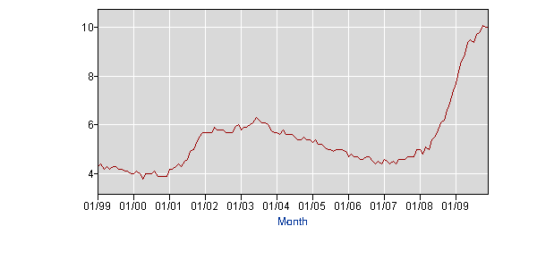
UNEMPLOYMENT

Slide 45
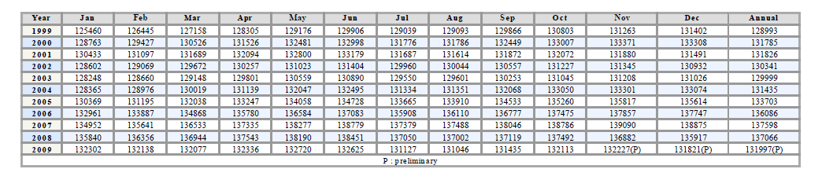
EMPLOYMENT

Slide 46
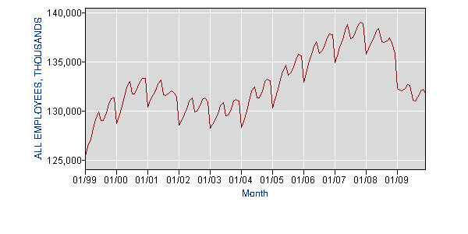
EMPLOYMENT GRAPH

Slide 47
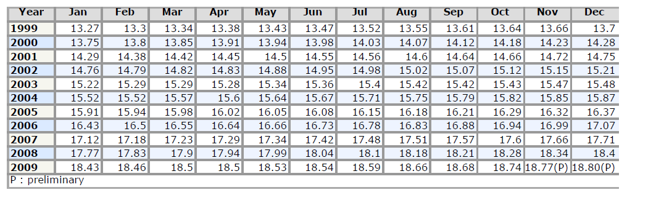
Average Hourly Earnings of Production Workers

Slide 48
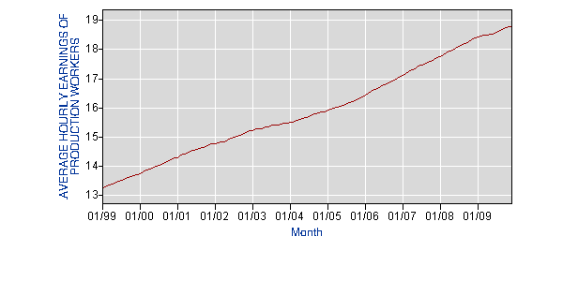
Average Hourly Earnings

Slide 49
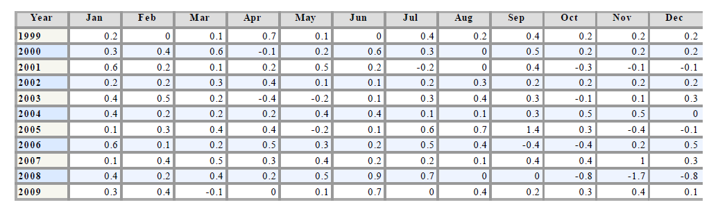
Consumer Price Index Annual Change %

Slide 50
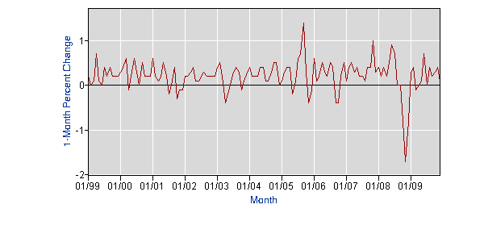
CPI Graph

Slide 51
What Have We Done
Nationalized the Banks buy purchasing very large amounts of “non-performing” assets some with very high leverage ratios (40 to 1).
Nationalized several large industrial manufacturers or assisted in their merger with other firms.
Passed a $787 billion “stimulus” package.
Expanded the money supply.

Slide 52
What Have We Done (Cont.)
Reregulating the Financial Sector.
“Reforming” Health Care.
Extended Unemployment Benefits.
Provided Mortgage “relief.”
Blamed Everyone – since Richard Nixon.
Now have an estimated $1.4 Trillion deficit.
Lost $13 Trillion in wealth.
Lost about 6 million jobs.

Slide 53
What Will Happen?
Damned if anyone really knows.
Certainly slower growth going forward (for how long?).
Inflation or deflation – at some point.
More rules – to be circumvented.
More older workers.
Europeanized health care.
A larger government sector.
New Economic Thinking about Business Cycles.

Slide 54
“The market can stay irrational longer than you can stay solvent.”
Long period of stagnation. Japan 1990…
Rearrangement in global economy.
Technological shift (ala the 1980 microchip or the 1910 auto, radio washing machine and electrification)
Large and growing deficits and ultimately a changed way of living.
UNCERTAINTY – UNCERTAINTY AND MORE UNCERTAINTY!

Slide 55
MORE ON WHAT TO EXPECT?
Tax and fee increases by states.
Longer work lives.
More Global Competition.
More moral hazard.
Less trust.

